Slide 1
MIS 632-A: Data Management Lab
Week 6: SQL Part 3
Mengfang Sun
msun7@stevens.edu

Slide 2
Reminders
We will continue to use the insurance claims database you built in the Week 3 Homework.

Slide 3
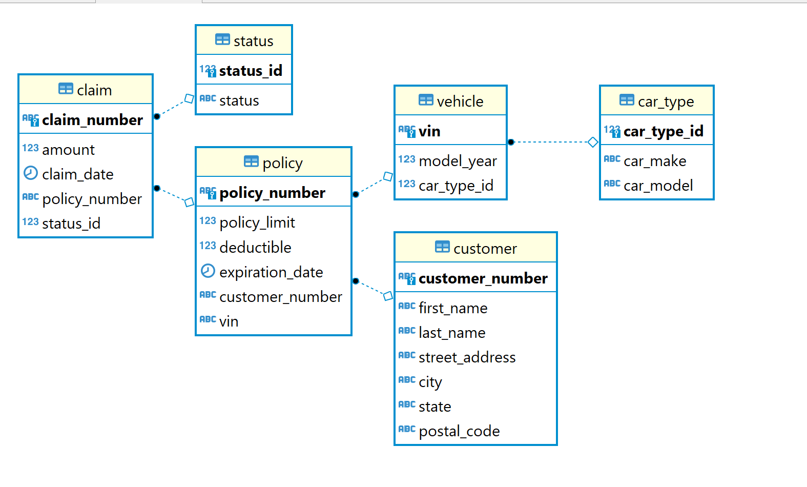
Insurance Claims DB ER Diagram

Slide 4
Agenda
Advanced Filtering
like / ilike
in / not in
Subqueries
Data manipulation
INSERT
UPDATE
DELETE

Slide 5
Advanced Filtering
Wildcard Matching
LIKE allows filtering with wildcard
ILIKE is the case-insensitive version of LIKE
% acts as the wildcard symbol in SQL
Matching a List
IN allows you to match one or more elements in a list
NOT IN allows you to match on all but the elements in a given list

Slide 6
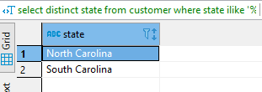
LIKE / ILIKE Examples
Wildcard character
select *
from customer
where last_name like 'Hal%';
select distinct state
from customer
where state ilike '%carol%';
Show each unique value only once
Case insensitive match

Slide 7
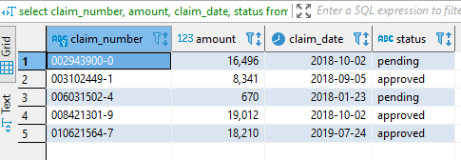
IN Example
select claim_number, amount, claim_date, status
from claim c
inner join status s on c.status_id = s.status_id
where status in ('approved', 'pending')
order by claim_number
limit 5;

Slide 8
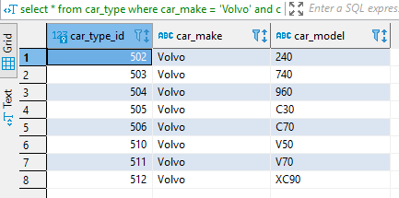

NOT IN Example
select *
from car_type
where car_make = 'Volvo' and car_model not in ('S60','S70','S90');
11 total car types by Volvo in the database

Slide 9

BONUS: Not Equal
select *
from car_type ct
where car_model = 'Prowler' and car_make != 'Chrysler';
select *
from car_type ct
where car_model = 'Prowler' and car_make <> 'Chrysler';
Not Equal

Slide 10
Subqueries
Subqueries let you evaluate a query on its own
Subqueries can be used in the FROM clause or in a WHERE clause (such as in conjunction with an IN)

Slide 11
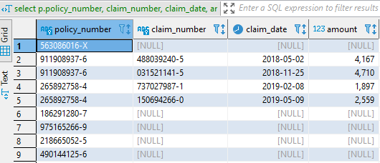
Subquery in FROM Clause
This query shows all policy numbers, but only shows claims information if the policy had a denied claim
select p.policy_number, claim_number, claim_date, amount
from policy p
left join
(select c.* from claim c inner join status s
on c.status_id = s.status_id where status = 'denied') sq
on p.policy_number = sq.policy_number;
Subquery enclosed by parentheses

Slide 12
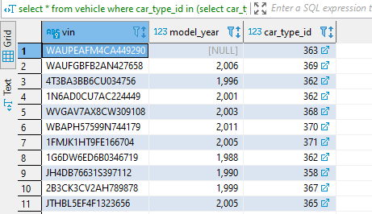
Subquery in WHERE Clause
This query shows all vehicle ID numbers (VINs) for all Mitsubishi cars
select vin
from vehicle
where car_type_id in (select car_type_id from car_type where car_make = 'Mitsubishi');

Slide 13
Data Manipulation
SQL queries can be used to change data within a database
INSERT statements add rows to an existing table
UPDATE statements change one or more columns in an existing table
DELETE statements remove one or more rows in an existing table

Slide 14
INSERT Statement Example
Field names of values to be inserted
Can be in any order, but order of values must match
Table to insert row
insert into car_type (car_type_id, car_make, car_model)
values (600, 'Stevens', 'Duck');
New value to be inserted
Multiple values can be inserted by separating sets of values with a comma

Slide 15
INSERT with SELECT Statement
Column order doesn’t match column order in table
insert into vehicle (car_type_id, model_year, vin)
select car_type_id, '1985', 'JTDBT4K33C1970518'
from car_type
where car_make = 'Toyota' and car_model = 'Prius';
SELECT statement allows you to lookup the car_type_id for a Toyota Prius in the query

Slide 16
UPDATE Statement Example
Table to update
New value
Field to update
update car_type
set car_make = 'Stevens Institute of Technology'
where car_model = 'Duck';
Criteria of WHERE to update
This is very important
Leaving off the WHERE clause will update EVERY ROW

Slide 17
UPSERT – Combining INSERT and UPDATE
You cannot insert multiple values of the same unique key (in this case, car_type_id) into a table
This will throw an error without the “ON CONFLICT” clause
This is a construct unique to postgres
insert into car_type (car_type_id, car_make, car_model)
values (600, 'Stevens', 'Duck')
on conflict do nothing;
The statement above inserts a new row only if there is no car_type_id = 600 and otherwise does nothing
insert into car_type (car_type_id, car_make, car_model)
values (600, 'St', 'Duck')
on conflict(car_type_id) DO UPDATE
set car_make = excluded.car_make,
car_model = excluded.car_model;
The statement above inserts a new row if there is no car_type_id = 600 and otherwise updates the car_make and car_model values for car_type_id = 600
Notes:
You cannot insert multiple values of the same unique key (in this case, car_type_id) into a table
This will throw an error without the “ON CONFLICT” clause

Slide 18

DELETE Statement Example
Use DELETE statements with extreme caution!!!
delete from car_type
where car_model = 'Duck';

Slide 19
Homework Assignment
Use the insurance claims database you created for the week 3 homework assignment to answer all questions in this assignment.
Please provide the code for the SQL query you used to answer each question. You may also be asked to provide additional information (see each question for details).
Questions:
What are the unique car makes for all vehicles that contain the letters “TM” in their vehicle identification number (VIN)?
In addition to the SQL query, show a table of the query results
Change the car make from “Chevrolet” to “Chevy” for every car model with that make in the car type table.
In addition to the SQL query, provide the answer to the following question: How many rows were updated?
Add a new pending claim for policy 104332058-X with the following details:
Claim Number: 565071285-9
Claim Date: December 31, 2018
Claim Amount: $5,000
Remove the policy associated with the vehicle that has a VIN ending in “21733”
5. Using at least one subquery, set the status of all claims with a date earlier than October 1, 2018 and a status of “pending” to have a new status of “denied.”
In addition to the SQL query, provide the answer to the following question: How many rows were updated?

